Slide 1
Dreams, Dreaming and the Subconscious
Hallucination vs vision

Slide 2
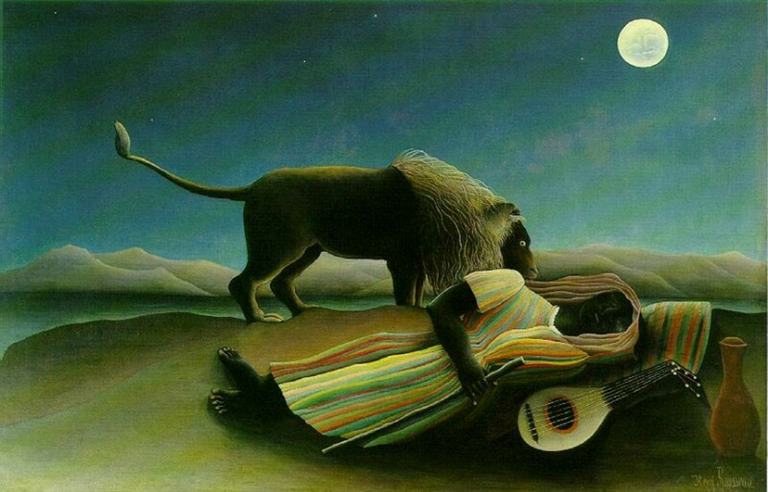
Henri Rousseau “Sleeping Gypsy”
Do you think Rousseau imagined this in a dream?
What meaning would you give the lion? Or the mandolin?

Slide 3
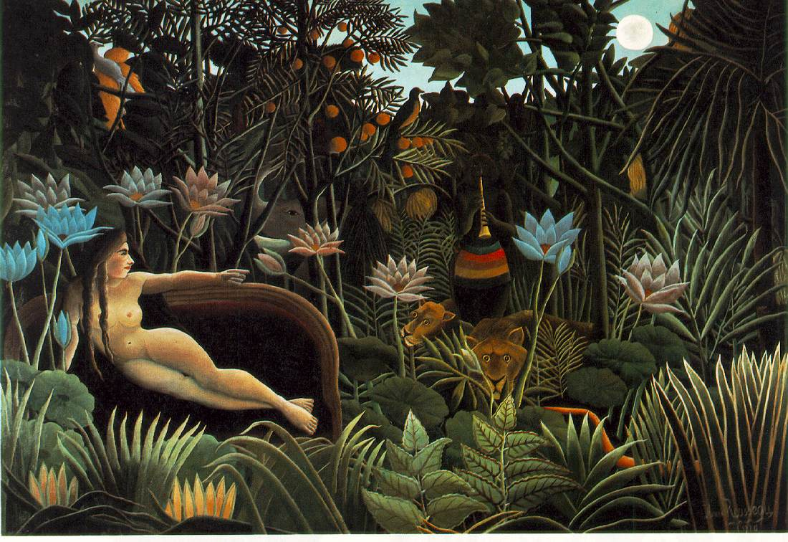
Henri Rousseau, The Dream
Rousseau never went to Africa, but at the time, travel books were very popular and widely read, not unlike we watch tv today as entertainment

Slide 4
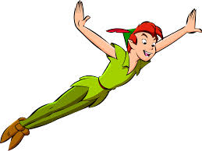
Fantasy
Visions
Hallucinations
Shutter Islandhttp://www.youtube.com/watch?v=V0eG0O9qNB4
http://www.youtube.com/watch?v=TongJJMgBeY

Slide 5
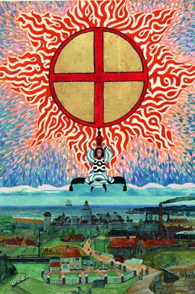
Carl Jung's first vision (awake):
“Europe covered in blood”
Foretelling of a machinated and bloody WWI.
Note the ship coming to their assistance from across the Atlantic
In the midst of a very successful career. ..”so profound it eventually caused the father of analytical psychology to undergo a series of waking fantasies. Traveling from Zurich to Schaffhausen, Switzerland, in October 1913, Jung was roused by a troubling vision of "European-wide destruction." In place of the normally serene fields and trees, one of the era's pre-eminent thinkers saw the landscape submerged by a river of blood carrying forth not only detritus but also dead bodies. When that vision resurfaced a few weeks later—on the same journey—added to the mix was a voice telling him to "look clearly; all this would become real." World War I broke out the following summer.

Slide 6
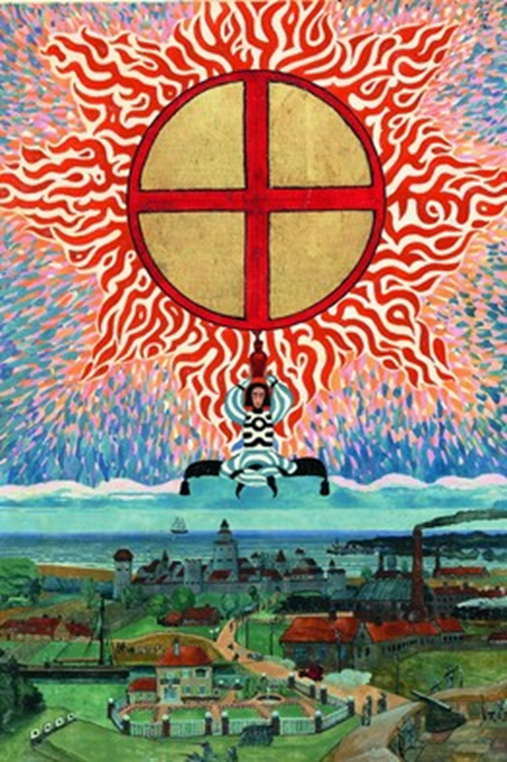
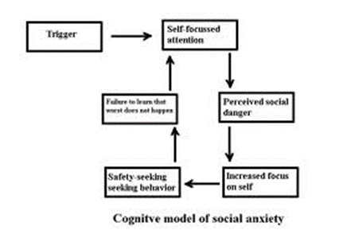
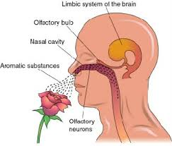
Visions
Eli Stone http://www.youtube.com/watch?v=08tPHCdha34&feature=related

Slide 7
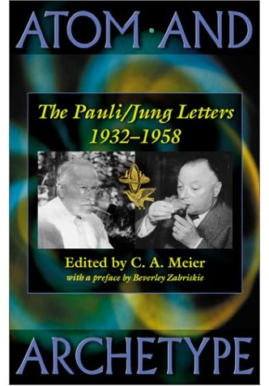
In 1932, Wolfgang Pauli was a world-renowned physicist and had already done the work that would win him the 1945 Nobel Prize. He was also in pain. His mother had poisoned herself after his father's involvement in an affair. Emerging from a brief marriage with a cabaret performer, Pauli drank heavily, quarreled frequently and sometimes publicly, and was disturbed by powerful dreams. He turned for help to C. G. Jung, setting a standing appointment for Mondays at noon. Thus bloomed an extraordinary intellectual conjunction not just between a physicist and a psychologist but between physics and psychology. Eighty letters, written over twenty-six years, record that friendship. This artful translation presents them in English for the first time. Though Jung never analyzed Pauli formally, he interpreted more than 400 of his dreams--work that bore fruit later in Psychology and Alchemy and The Analysis of Dreams. As their acquaintance developed, Jung and Pauli exchanged views on the content of their work and the ideas of the day. They discussed the nature of dreams and their relation to reality, finding surprising common ground between depth psychology and quantum physics. Their collaboration resulted in the combined publication of Jung's treatise on synchronicity and Pauli's essay on archetypal ideas influencing Kepler's writings in The Interpretation of Nature and the Psyche.
Carl Jung
The Pauli Principle & Quantum Physics
Link to Amazon: http://www.amazon.com/gp/product/images/0691012075/ref=dp_image_0?ie=UTF8&n=283155&s=books

Slide 8
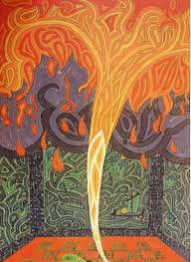
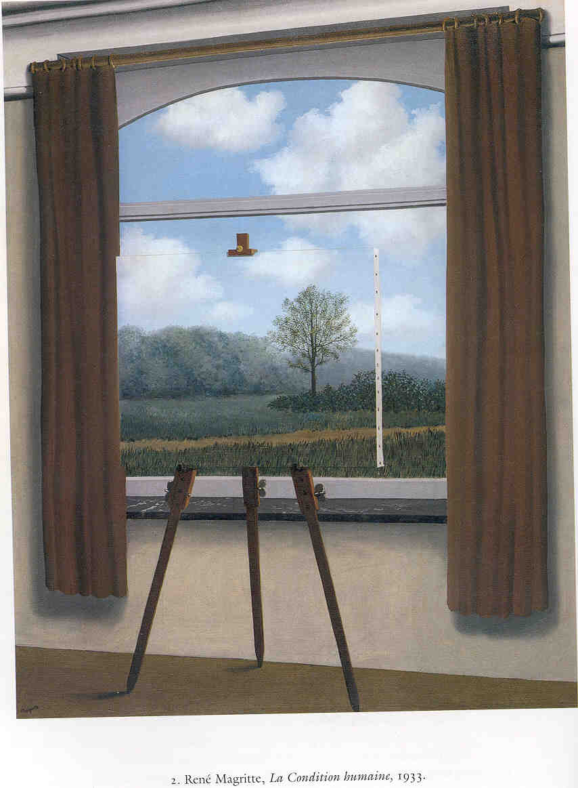
The house, as a metaphor
Carl Jung’s dream theory evolved from one of his own dreams about his house; he realized that the house is a metaphor for the person, his personality and his life
-could be used as a framework to analyze dreams
- for ex. the cellar is lowest self; the attic our highest, the living room our social self
-evolved to Analytical Psychology
Rene Magritte: a room with a view. Is that what our body is?
A whirlwind forming inside a room
& inside Jung’s mind?

Slide 9
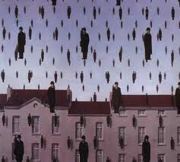
Magritte: “Golconda”
Using Jungian depth psychology, this person is not restricted by the constraints of a body. He’s floating everywhere, and outside his house!

Slide 10
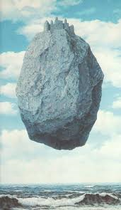
Magritte
Castle in the Pyrenees
What would your depth psychology analysis of this painting/dream be?
His house has a huge rock solid foundation- and everything is floating or flying freely including the house.
Water is a universal metaphor for life.

Slide 11
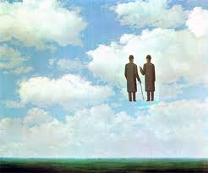
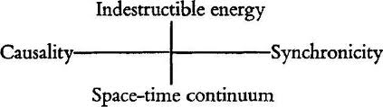
Magritte,
Infinite gratitude

Slide 12
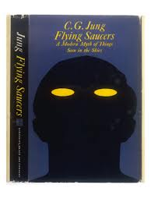
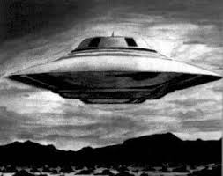
Carl Jung and Flying Saucers
psyc psychosocial hypothesis (PSH)
In ufology, PSH argues that at least some UFO reports
are best explained by psychological or social means
Chaos of War
Psyche Traumatized
Projecting flying saucers
To regain sense of order
A Life Worth Living http://alleydog.com/topics/motivation.php#.UhEMMPU_cSd

Slide 13
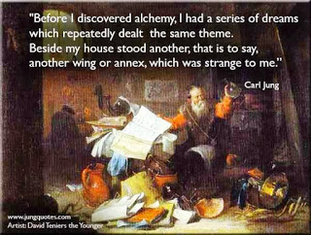
Carl Jung: symbolism of Houses

Slide 14
Jung’s Dream Theory of Amplification
Freud uses association and looks for lots of them to find meaning- Jung is the opposite and uses Amplification - concentrate on the image or action the way it is in the dream, and then dig down and explore the depth of it and the implications of that (not the breadth)
Amplification involves the use of myth, history, and cultural parallels in order to clarify
“turn up the volume” to bring understanding, especially if it’s difficult
Connects the dreamer to answers/meaning greater than himself- to understand it beyond his own persona self
(There is some disagreement with the idea of connecting a person to those with similar problems because sometimes a person needs to heal himself and not connect to a greater conscious in the process. Others argue it makes the person feel much grander than he is)

Slide 15

Stream of consciousness
River of dreams
http://www.youtube.com/watch?v=hSq4B_zHqPM

Slide 16
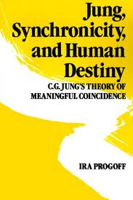
Carl Jung
Analytical Psychology
House is the framework to understanding
the psyche, and dreams
Individuation
Collective Unconscious
Synchronicity
Dreams guide you to a wholeness
-offer solutions to problems
Everything can be paired as opposites
  Ego (your sense of who you are)
    Alter-ego/ shadow

Slide 17
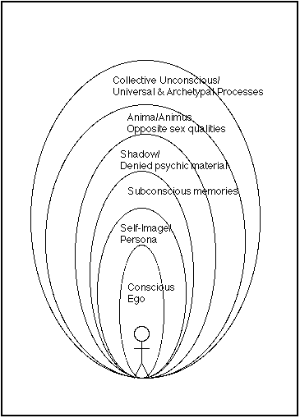
Jung’s Theory: Collective Unconscious
Personal unconscious
              Personal Library
              Memories and experiences
              Archetypes
              Puns, metaphors and personal myths

Slide 18
Blank slate tabula rasa
Freud believed we were born a blank slate
Jung said we are not born a blank slate

Slide 19
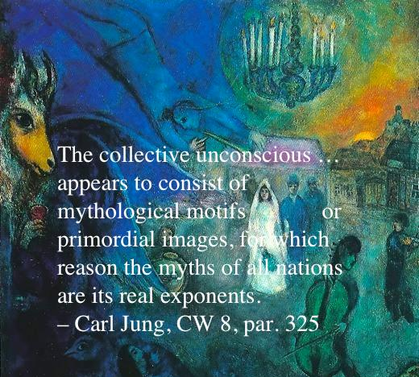
Collective Unconscious
- a secondary consciousness
Myths
Imagination
Inherited
Can’t be acquired because it’s innate
Primordial images and ideas
Mental ideas that cannot be explained
from our own personal life
What we all have in common as a species
Can be numinous
Communion with a divine or world mind
An unconscious energy that lives forever
https://www.youtube.com/watch?v=yAgIdXjawks

Slide 20
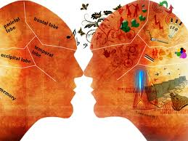
The collective unconscious
Avatar: a movie about the collective unconscious

Slide 21
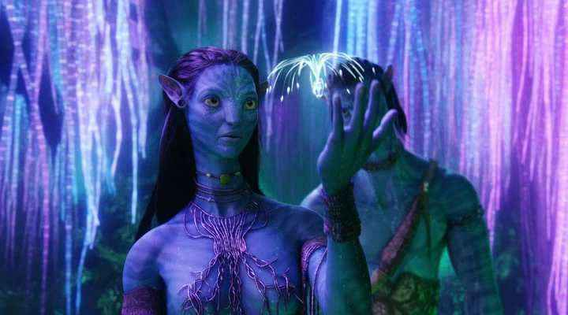
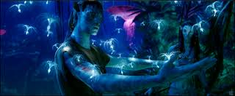
The Collective Unconscious
in Avatar, the Sacred Tree, The Tree of Souls, Tree of Voices
and the vast network of roots, which they connect to by using their braids, are their collective unconscious (which they treat divinely)
** Energy is borrowed and one day you have to give it back. (life & death)

Slide 22
Collective unconscious
the sum of all thoughts, memories, impulses, desires and feeling of which you are
not aware
influence your emotions and behavior.
The collective unconscious is a way to organize and interpret our experiences,
to see how we are similar to each other, and become aware of each other
The collective unconscious is the repeating symbols, signs, elements and images
that carry and convey messages
Universal collective unconscious
  Universal library
  Archetypes
  Magical realm
  Shared experiences
  Shared dreams
  On the “same wave length.” resonating
  Astral plane

Slide 23


Pauli effect synchronicity, the intender
https://www.youtube.com/watch?v=TN9vqSHBEMs

Slide 24
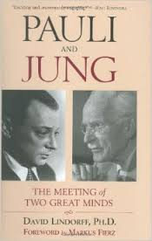
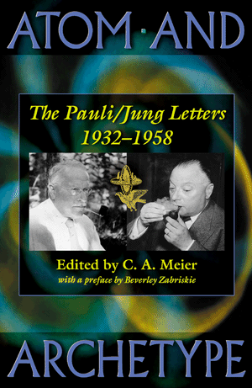
Synchronicity a cluster of a meaningful coincidence
https://www.youtube.com/watch?v=BX_nMwYa-nw

Slide 25

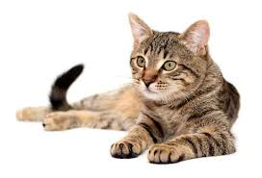
superposition
Carl Jung – Synchronicity
Pauli-
Quantum Mechanics
I’m a kitty!
Schrodinger’s Cat

Slide 26
Schrodinger’s Cat
I’m a kitty
-a cat, a flask of poison, and a radioactive source are placed in a sealed box
-poison kills the cat.
-after a while, the cat is simultaneously alive and dead
when one sees the cat either alive or dead, not both alive and dead.
This poses the question of when exactly quantum superposition ends and reality collapses into one possibility or the other.
Big Bang Theory:
http://www.youtube.com/watch?v=pNTMYNj2Ulk

Slide 27
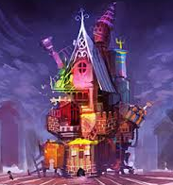
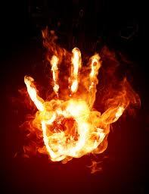
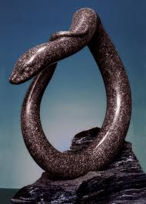
Four universal symbols: (archetypical)
1. House: you/your personality
  Village or City: your greater self, family or community
  2. Water: Source of Life ---Essential to life
  Thirst
  Serenity (or crashing waves)
  Baptism
3. Fire: Opposites- passion life or destruction
  Passion
  Birth: Phoenix, transformational
  Heat, light, comfort
  Destruction
  Fear
4. Snake: multiple meanings
(For ex. To Indians, they’re spiritual guides, to Christians they’re serpents)
-fertility
- healing/nurturing
-circle of life, shed your skin
-circles the staff as a symbol of the Medical Profession
-sin and evil temptation
- Forked tongue
Kekules dream about snakes helped him see carbon structure as a circle

Slide 28
Major Archetypes:
  Persona- the image we create
  In the dream world, the persona is represented by the Self
  -may or may not resemble you physically
  -may or may not behave as your would.
  Shadow- the image we don’t want the world to see
  -you may think its ugly or unappealing, for example
  -symbolizes weakness, fear, or anger.
  Anima and Animus- the female and male aspects of yourself.
  Divine child- your true self in its purest aspect
  -symbolizes your innocence, your sense of vulnerability
  -your helplessness
  -represents your aspirations and full potential
Harper Simon: Wishes and stars
http://www.youtube.com/watch?v=d82Dz1DW2BM

Slide 29

Archetypes, cont.
  Wise old man/woman- offers guidance and words of wisdom
    Dream helper
    Represented by a teacher, father, doctor, priest
    An unknown authority figure
    They appear in your dream to steer and guide you into the right direction.
  Mother- a nurturing identity
    mother, grandmother
    Any nurturing figure in your dream who gives you a positive and reassuring
    A river of life
  Trickster -plays jokes to keep you from taking yourself too seriously
    may appear in your dream when you have misjudge a situation.
    uncertain about a decision or about where you want to go in life.
    makes you feel uncomfortable or embarrassed
    mocking you or exposing you to your vulnerabilities
    take on subtle forms, sometimes even changing its shape.
  Hero- the hero who lives inside you

Slide 30
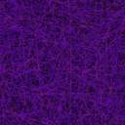
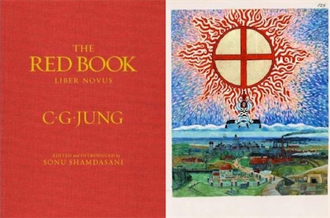
Carl Jung
Dream Journal - extraordinaire

Slide 31
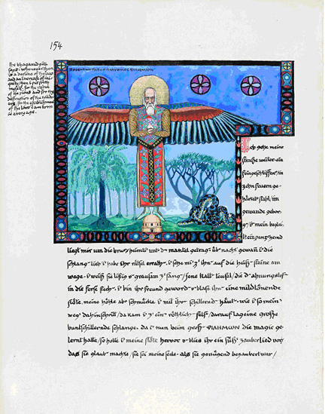
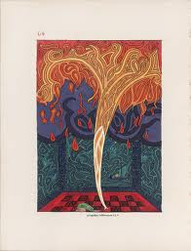
Carl Jung’s
Spirit Guide
Dream Helper
Philemon
(from a dream)
Originally,
Jung drew
Philemon without wings.
When he added wings, like a kingfisher, a few days later he found a dead kingfisher in his garden. Jung viewed this as very synchronistic.

Slide 32
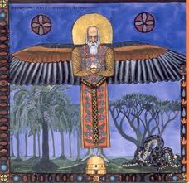
A snake coiling upon itself.
Philemon is shown with a halo
standing on what looks like a beehive,
holding a -?
If the beehive is a house, does it represents Jung?

Slide 33
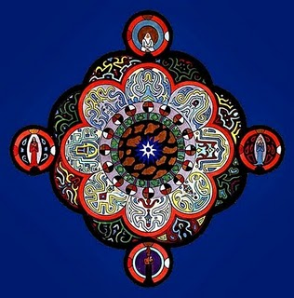
Jung drew many of these Mandala, starting in 1917 when he was treating British POWS

Slide 34
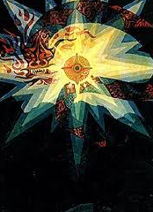
A dragon
A burst of light

Slide 35


A flame coming from a serpent’s mouth- a forked tongue, or is it a tree of life? Above ground, or below? Is the snake an erupting volcano?

Slide 36
A genie rises from out of a -?
Or is it a legendary bird?

Slide 37
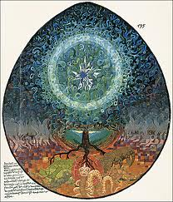

Slide 38
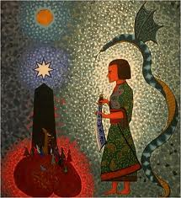

Slide 39
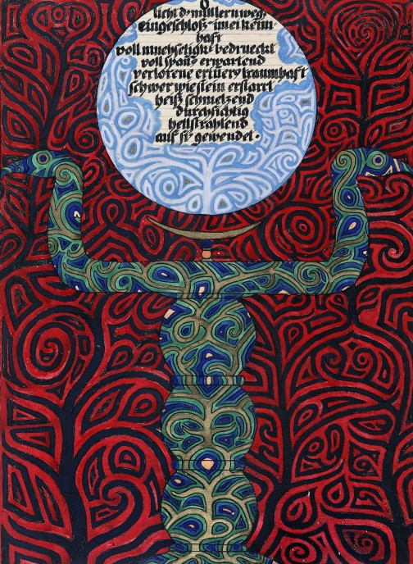

Slide 40
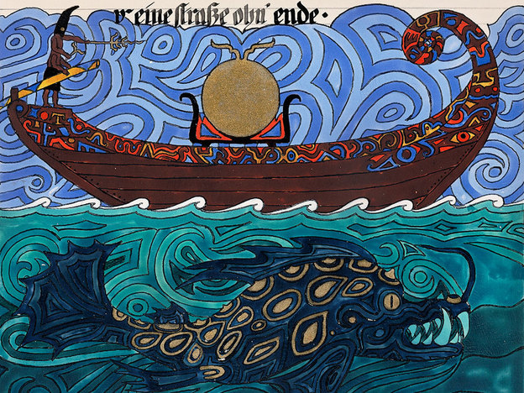

Slide 41
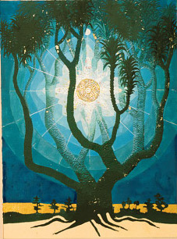
Carl Jung’s Red Book

